Slide 1
By: Isaac Owusu Akowuah
TransBorder Freight Data Analysis.
A Deep Dive into Cross-Border Freight Trends and Recommendations in USA, Canada AND Mexico.

Slide 2

Title and Content Layout
Project Title
Table of Content
Business Questions
Key Insights
Recommendations

Slide 3
Business Questions
What is the total value of goods transported?
What is the number of freight movements?
What is the most used transportation mode?
What are the trends in value over the years?
What are the top 4 U.S. states by Goods value?
How does weight vary by month and country?
What actionable insights can be derived?

Slide 4
Total value of goods transported and number of freight movements
Total Value Transported:
$108.9 Trillion
Number of Freight Movements: 35 Million
$108.9T
35M

Slide 5
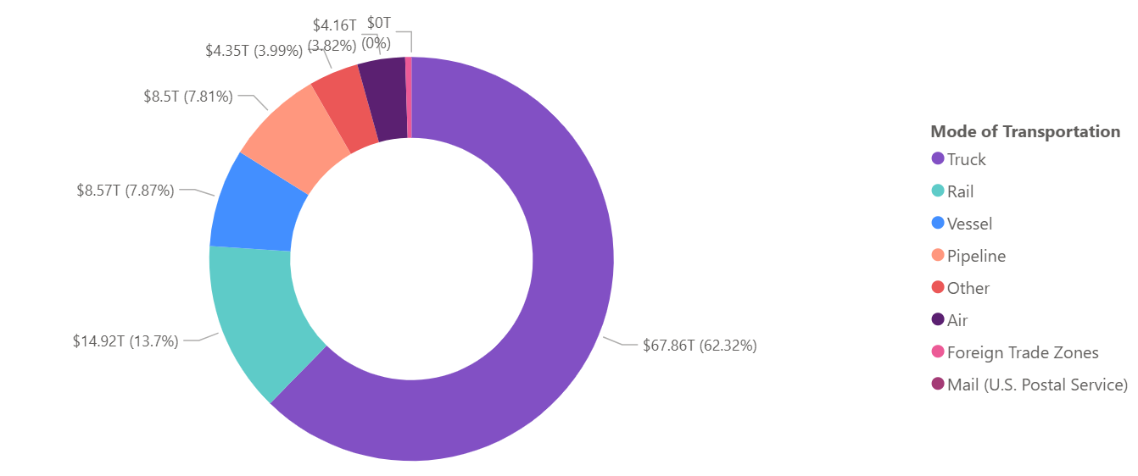
Mode of Transportation by Value
Truck is the dominant mode for freight transportation
The truck route of transportation has 62.32% of all the transportation routes.
The value of goods transported via the truck route is $67.86 trillion.
Railway lines follows with 13.7% having a total value of $14.92 trillion.

Slide 6
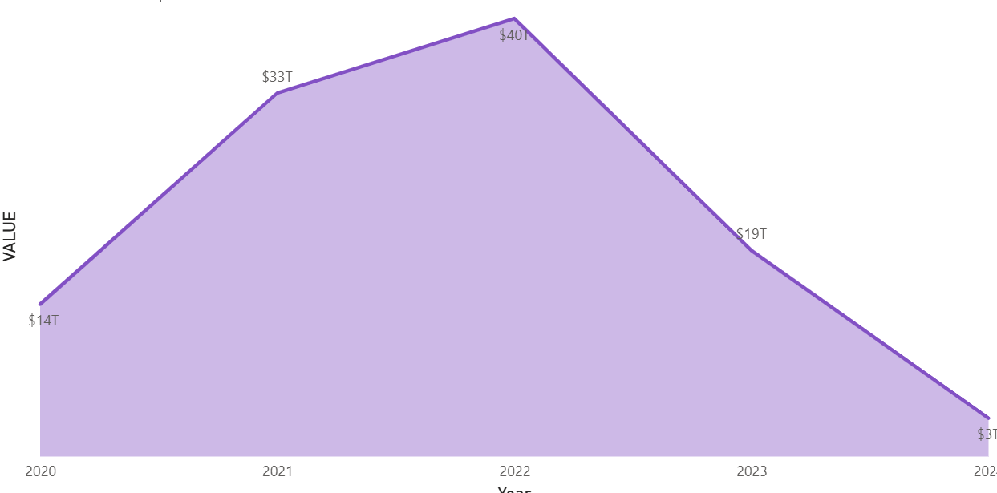
Trend by Year and Value
There is a gradual rise in the value of goods transported from 2020 to 2022.
The value of goods peaks in 2022
A noticeable decline in 2023 and 2024, from 19 trillion to 3 trillion.

Slide 7
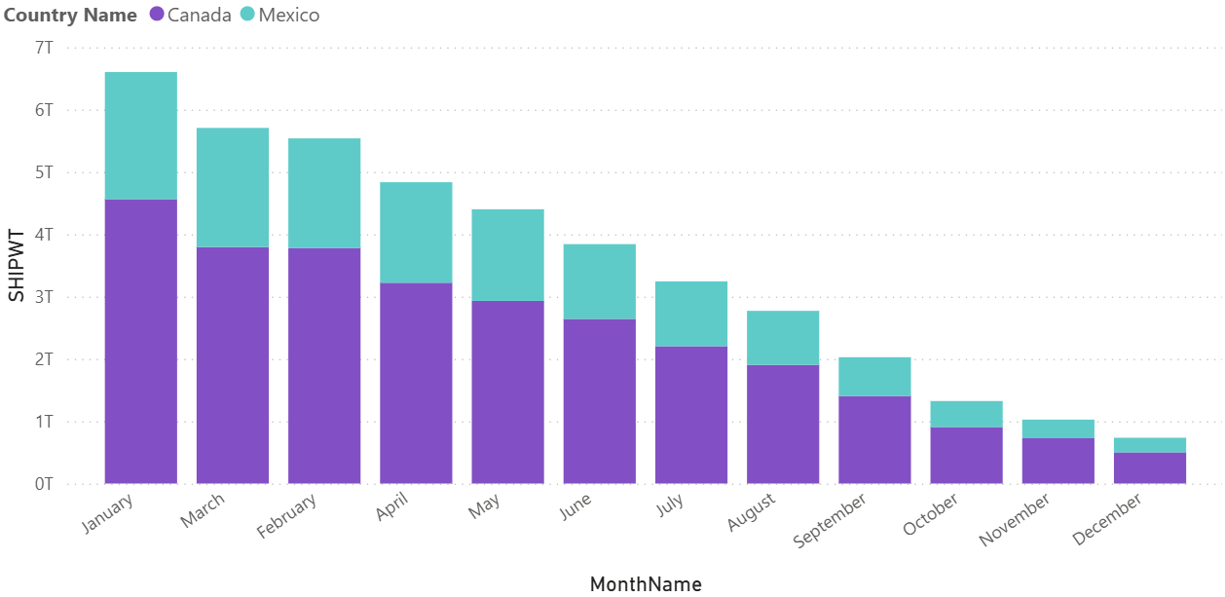
Shipping Weight by Month & Country (Canada and Mexico)
Top 2 Months for Weight Transported: January and March
Overall Canada leads as the country with huge volume of goods transported over Mexico.

Slide 8
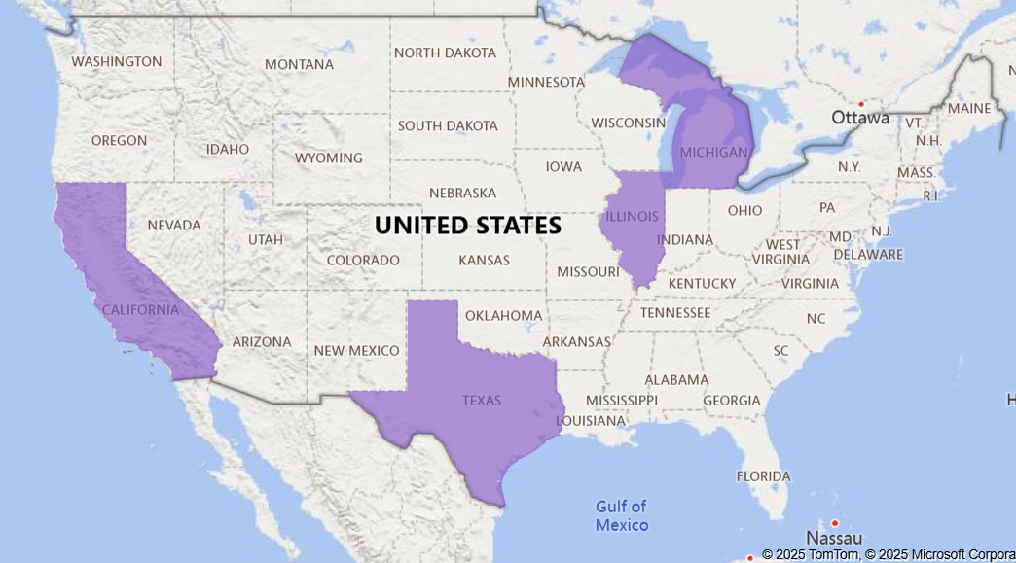
Top 4 USA State by Goods Value
Texas is the leading state where high value of goods are transported.
Michigan, California and Illinois follows as the next top three states
Texas led with $15.8 Trillion in transported goods

Slide 9

Recommendations
Invest in infrastructure support for road transport: such as improving highways and border facilities.
Promote digital logistics tools: To increase trucking efficiency, promote the use of route optimization systems.
Root-cause analysis: Conduct a root-cause analysis (e.g., cost of transportation, demand decline, geopolitical disruptions).
Policy planning: Policy planning around these top states (Texas, Michigan, California, Illinois) to streamline trade corridors.

Slide 10
Recommendations
Bottlenecks or missed opportunities: Benchmark other states against Texas to identify bottlenecks or missed opportunities.
Plan maintenance or upgrades: Plan maintenance or upgrades outside of peak months to minimize disruption.
Bilateral trade and infrastructure: Focus bilateral trade and infrastructure discussions more heavily with Canada.

Slide 11
THANK YOU

